Slide 1


New England Electricity Restructuring Roundtable
Kathleen Theoharides, Secretary
Massachusetts Executive Office of Energy and Environmental Affairs
March 26, 2021

Slide 2
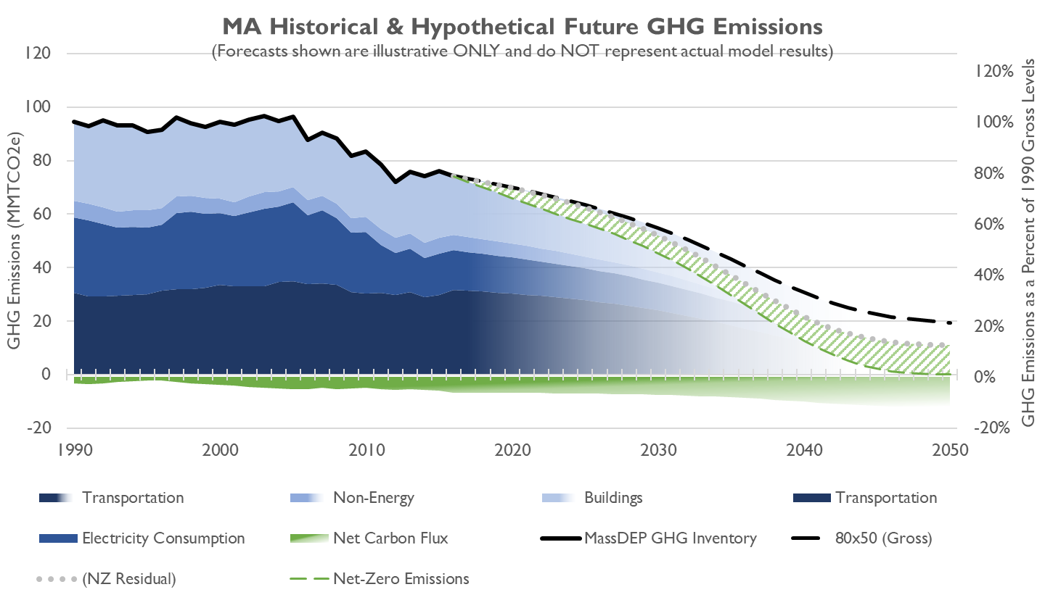
Net Zero

Slide 3



2050 Roadmap: Top-Level Findings
Massachusetts can achieve our 2050 climate goals, and if we are smart about our approach and the strategies we select:
Can do so affordably
  Maintain a thriving economy
        Ensure we bring everyone along, especially our most vulnerable residents

Slide 4




2050 Roadmap: Key Findings
Commonwealth has a range of options, but the most cost-effective, low-risk pathways share core elements:
A balanced clean energy portfolio anchored by a significant offshore wind resource
More interstate transmission to allow us to access renewable generation in other states and in Canada
Widespread electrification of transportation and building heat
Reduce cost by replacing energy infrastructure at end of service life.

Slide 5



How Do We Get to 2030?
MA Clean Energy and Climate Plan
New Buildings: Highly-efficient new construction
Existing Buildings: ~ 1,000,000 Homes and ~ 350 million sq-ft of commercial property retrofitted with clean heating, high-efficiency insulation
Building Heat: Fewer residential and commercial gas customers than today
Light-Duty: Over 750,000 new EVs cars & trucks on the road
Med. & Heavy: ~20,000 new ZEVs on the road + cleaner diesel fuel blends
Miles Travelled: 15% reduction in light-duty commuter miles traveled
Generation: 6,000 MW of new clean energy built and interconnected
Transmission: First of several new regional transmission lines operational
System: New ISO-NE transmission planning & clean energy markets are ready to add 1GW offshore wind & 500MW of solar every year, plus 2 or 3 more large transmission lines, through 2050

Slide 6
2030 CECP Policy Proposals
Buildings
Transportation
Electricity
  Execute on Existing Procurements + Additional 2,000MW Clean Energy
  Review & Revise Clean Energy Programs & Include MLPs
  Revise Wholesale Energy Markets & Planning
  Pivot MassSave
  High-Efficiency Energy Code
  Cap Heating Fuel Emissions
  Convene Commission on Clean Heat
  Transportation and Climate Initiative Program
  Implement 100% new EV Sales by 2035 & Advanced Clean Trucks/Fleets
  MOR-EV Program
  EV Charging + Smart Charging
  Work with partners/stakeholders to explore Low-Carbon Fuel Standard
  Limit Commuter Vehicle Miles Traveled

Slide 9
2030 CECP: Scaling Clean Electricity Regionally
Execution of Procurements
Focus in the 2020s on fully executing the Commonwealth’s existing solar, offshore wind, and hydropower procurements.
Aligned and Committed Regional Energy System
New England Governors’ October 2020 statement + NESCOE Vision
Commonwealth is actively working with other New England states to ensure that the states are served by a regional electricity system operator and planner that is a fully committed partner in their decarbonization efforts.

Slide 10
Overview of S.9 An Act creating a next-generation roadmap for Massachusetts climate policy
The legislation addressed several climate initiatives, including:
    Increasing authorization for offshore wind procurement to 4,000 MW
    Codifying environmental justice principles and incorporates protections for environmental justice populations into the MEPA review process
    Adopting energy efficiency standards for commercial and residential appliances
    Expanding GWSA requirements to create pathway to achieving net zero by 2050 and codifies this emissions limit

Slide 11


Administration Amendments to S.9
Key Technical Details
GWSA Updates
EE Building Code
Environmental Justice

Slide 12
Thank You!
Notes:
As you can see, we have a lot of work ahead of us as we continue to address climate change and build a clean energy future for Massachusetts.
We look forward to our continued partnership with you on these important initiatives.
Thank you again for having me today.

